Slide 1
Payment for Ecosystem Services (PES) in Knuristan: Potential for collaborative conservation and development
Brad Kozel – Ngo director
Notes:
NGO director…
…Aim to preserve ecosystems and species and to promote development that respects the environment…
The Indigenous reserve on knuristan island has potential for this type of conservation and development
Specifically, Payment for Ecosystem services is a good way to go….

Slide 2
Ecosystem Services in Knuristan Indigenous Reserve
Ecosystem services within the Indigenous Reserve
Provisioning
Food – cyclic farming by indigenous people
Food – Palm Nut local use and developing market
Wood – Ministry of Forests Logging
Regulating
Climate Regulation – Dense rain forests
Water Purification – Dense rain forests
Cultural
Aesthetic, spiritual, educational and recreational – valued by the indigenous people
Aesthetic, educational and recreational – potential value for extension of ecotourism
Headings taken from Millennium Ecosystem assessment
Notes:
Ecosystem services with in the indigenous reserve .
Additional services outside the reserve on Kusini island…depending on the scope of the potential project this area could be included.

Slide 3
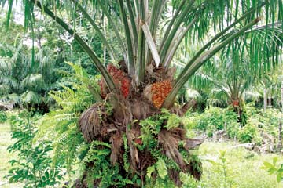
Potential of PES in Knuristan Indigenous Reserve
Empowering Indigenous People to….
Conserve existing trees and replenish rare species
Payment and education for sustainable farming and cultivation of Palm Nut trees
Payment for cultivating and planting rare trees
Successes seen in Cambodia (Clements T et. al. 2010) and Nicaragua (Kosoy N et al)
Notes:
Cambodia project….payment for abiding by land use and no hunting rules
Nicaragua project… farmers paid to convert farming to forest lands, and to manage lands in a specific way (agricultural/pastoral) land

Slide 4
Potential of PES in Knuristan Indigenous Reserve
Empowering Indigenous People to….
Develop an extension to an already existing ecotourism industry
Payment for the aesthetic and recreational services contained within the reserve
Payment for the potential educational value of the reserve
Develop land use policies that govern logging within the reserve
Protect local wild life and participate in eradication of invasive rat species
Successes seen in Cambodia (Clements T et. al. 2010) and Nambia (Naidoo et al 2011)
Image: Natural Habitat Adventures
Notes:
Cambodia project… revenue from ecotourism used to fund conservation efforts and PES
Nambia (Federal gov)…revenue from safaris shared with people, incentives to conserve wildlife
Eradication projects involvement of local people, jobs????
Erradicate rats to protect the Knuristan Knot

Slide 5
Thoughtful PES planning and implementation
Harley, R. et al. (2012), REDD+ Beyond Carbon: Insights from a Community Payments for Ecosystem Services Project in Cameroon.
Unless projects are rooted in an understanding of evolving institutions, constraints and opportunities, it is difficult to make progress towards the hoped-for changes. Institutions are the ‘formal and informal rules that shape human interaction’ (North 1990), patterns that anchor behaviour over time.
Notes:
The context of each conservation and development challenge is unique and requires carful planning and engagement with stakeholders, especially the indigenous communities.
Cameroon project…addresses carbon, limit deforestation etc…

Slide 6
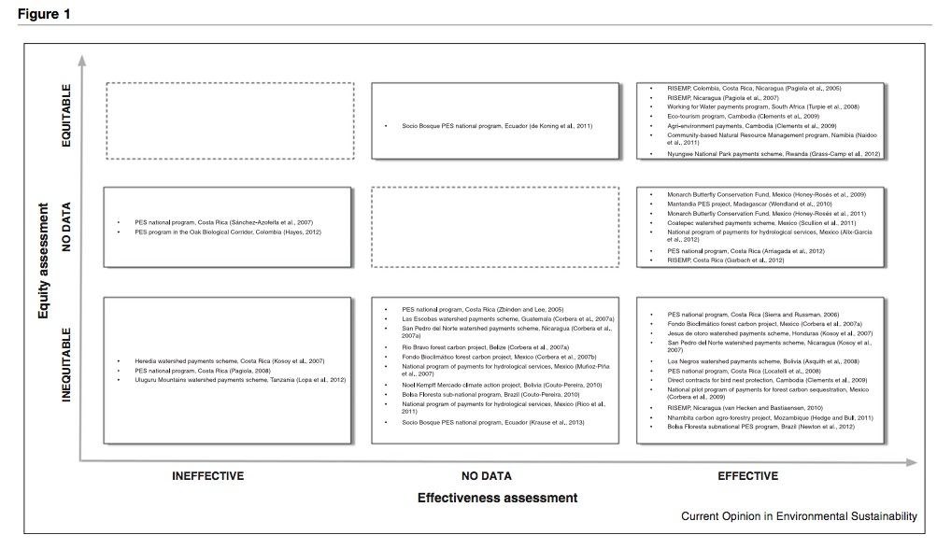
Thoughtful PES planning and implementation
Calvit-Mir et al. (2015). Payments for ecosystem services in the tropics: a closer look at effectiveness and equity.
When looking at equity and effectiveness variability exists but there are projects that achieve both.
Notes:
Calvit-Mit pg 155-156. Effectivnes Scholars analyze PES effectiveness in terms of (i) changes in the level of ecosystem service provision, that is, if the service targeted increases or decreases; (ii) changes in land-use or habitat provision, that is, if payments maintain or expand the type of land-use or habitat that is used as a proxy of ecosystem service delivery; or (iii) the combination of both variables
Equity….We classified the author(s)’ analytical approach to equity following a three-tiered framework: (a) equity in access, if the author(s) examined local people’s ability to participate in the PES program; (b) equity in decision-making, if the author(s) analyzed participants’ perceived fairness in project decision-mak- ing procedures; and (c) equity in outcome, if the author(s) focused on the impact and distribution of project out- comes, including income, across participants

Slide 7
Potentially Excellent Situation sigh
Ecosystem services are tangible
Already existing ecotourism industry
Potential for conservation of biodiversity and benefit to indigenous peoples: win-win
Models exist to guide thoughtful planning that can balance effectiveness and equity
Bibliography
Kosoy N, Martinez-Tuna M, Muradian R, Martinez-Alier J: Payments for environmental services in watersheds: Insights from a comparative study of three cases in Central America. Ecol Econ 2007, 61:446-455.
Howald, G., Donlan, C., Galván, J.P., Russell, J.C., Parkes, J., Samaniego, A., Wang, Y., Veitch, D., Genovesi, P., Pascal, M. and Saunders, A., 2007. Invasive rodent eradication on islands. Conservation biology, 21(5), pp.1258-1268
Clements T et al.: Payments for biodiversity conservation in the context of weak institutions: comparison of three programs from Cambodia. Ecol Econ 2010, 69:1283-1291.
Naidoo R, Weaver LC, De Longcamp M, Du Plessis P: Namibia’s community-based natural resource management programme: an unrecognized payments for ecosystem services scheme. Environ Conserv 2011, 38:445-453.
Calvit-Mir et al. (2015). Payments for ecosystem services in the tropics: a closer look at effectiveness and equity.
Harley, R. et al. (2012), REDD+ Beyond Carbon: Insights from a Community Payments for Ecosystem Services Project in Cameroon.
MacArthur Foundation. https://www.macfound.org/programs/conservation/
Millenium Ecosystem Assessment. Ecosystems and Human-well being synthesis. http://www.millenniumassessment.org/documents/document.356.aspx.pdf

